Slide 1
Lecture4 Part1 Initiation Phase (Cont)
Reading: Main text, Chp6; Sup text, Chp 5
Lek Hsiang Hui

Slide 2
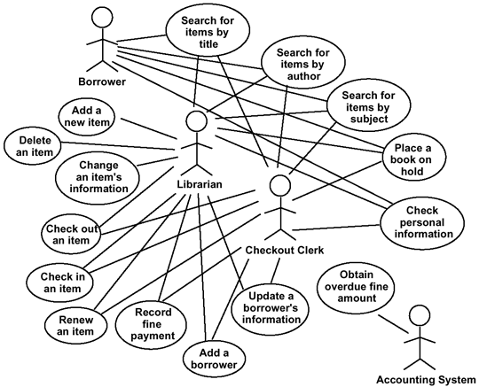
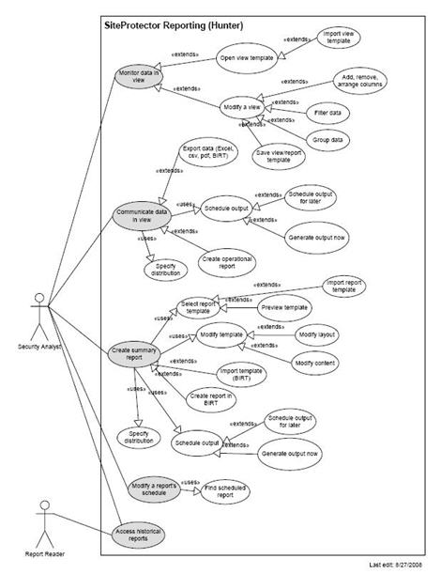
Real-world systems are usually very complicated

Slide 3
Organizing Use Cases

Slide 4
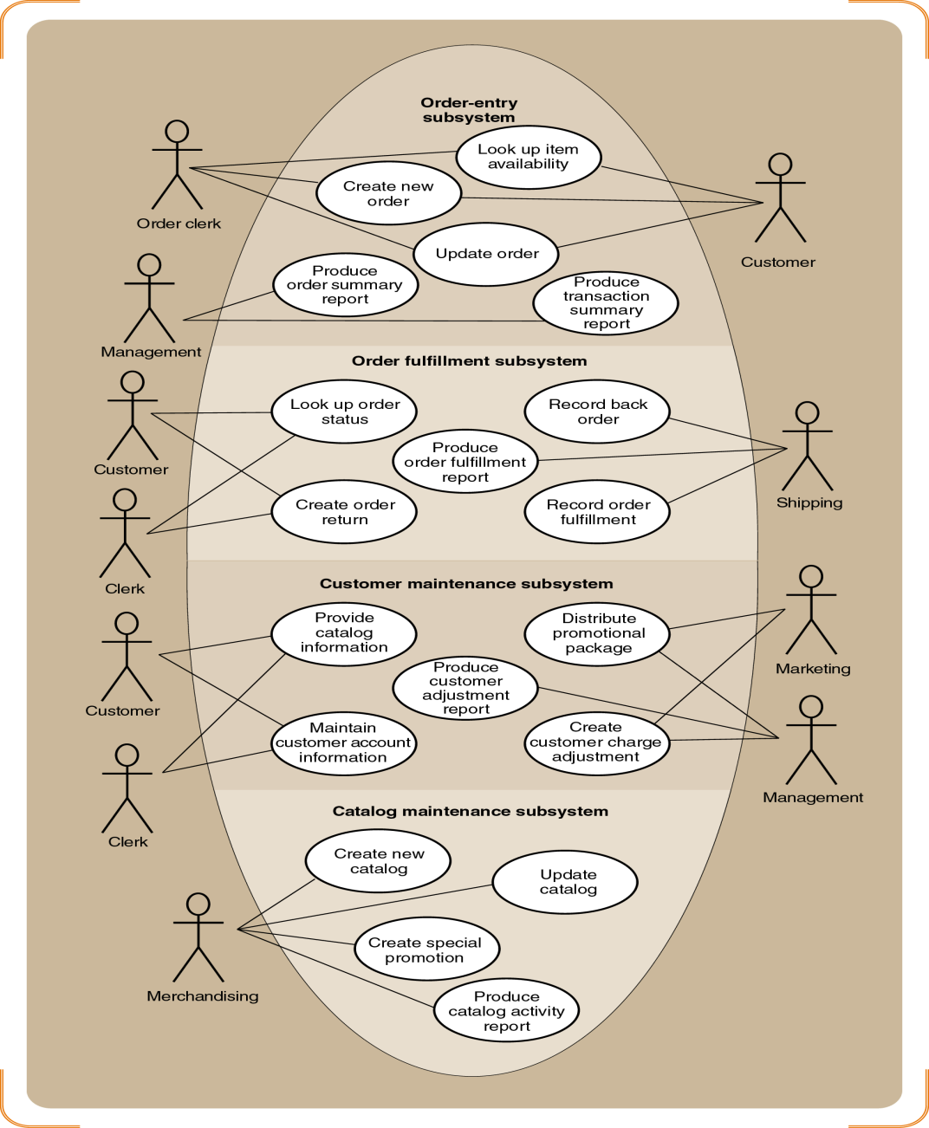
Organizing Use Cases
Organize use cases by specific actor (e.g. activities handled by the clerk)
Organize use cases by subsystem (e.g. customer transaction sub-system, payroll system)

Slide 5
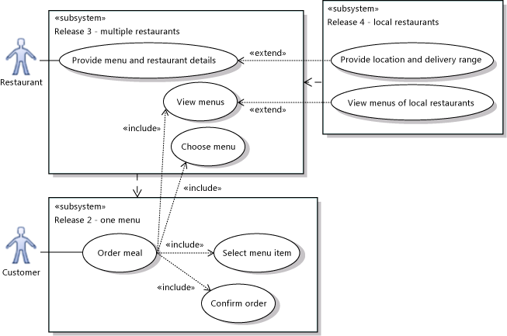
More subsystem examples
Taken from microsoft.com

Slide 6
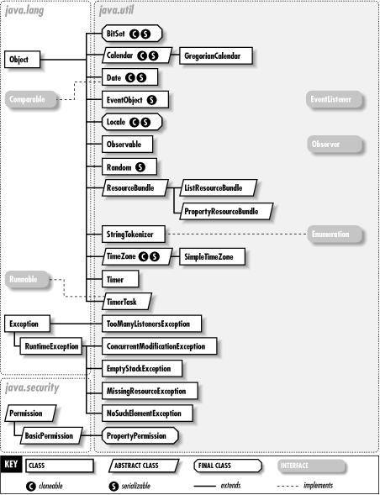
In Java, Packages are used to organize Classes
Can apply the same idea to use case diagram

Slide 7
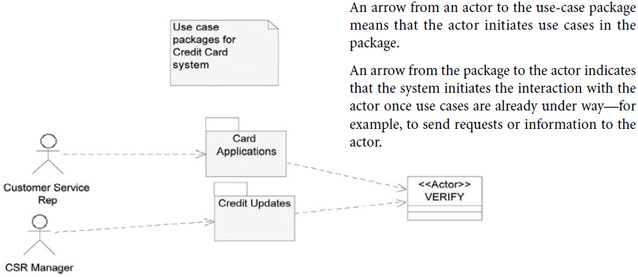
System Use-Case Package

Slide 8
When to use Package?
Common approaches used to group system use cases into packages:
Group system use cases by the main actor who uses them e.g. group together into one package all the system use cases used by the general administration

Slide 9
When to use Package?
Create a system use-case package for each business use case
E.g. for an insurance system - “Make a Claim” use case:
To the customer, it represents one business goal
However, to achieve it, the company’s workers (actor) require a number of discrete interactions with the computer system such as Record Claim, Validate Policy, Adjust Claim, Pay Claim
Each of these interactions qualifies as a system use case
Bundle them all in the use-case package Make a Claim

Slide 10
When to use Package?
There’s no one single right/wrong way to organize use cases most important thing is to organize it in a manner that improve readability
Create a system use-case package for each business use case
E.g. for an insurance system - “Make a Claim” use case:
To the customer, it represents one business goal
However, to achieve it, the company’s workers (actor) require a number of discrete interactions with the computer system such as Record Claim, Validate Policy, Adjust Claim, Pay Claim
Each of these interactions qualifies as a system use case
Bundle them all in the use-case package Make a Claim

Slide 11

How do we name the subsystem and packages?

Slide 12

Before we end this chapter… What’s the purpose of use case diagram again?

Slide 13
These are not wrong but does it serve its purpose?

